Slide 1
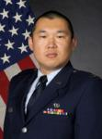
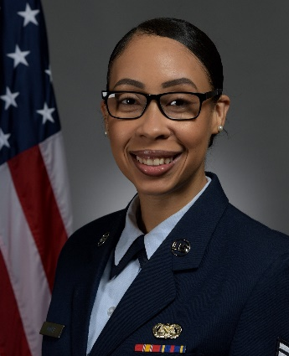
Air & Space Force
Victims’ Counsel (VC)
What VCs do for sexual assault and domestic violence victims:
Provide confidential legal advice
Advocate your voice and choice
Protect your rights & privacy interests
Advise you on the investigation & prosecution process
Represent you in interviews, hearings, and military trials
Who does the VC work for? YOU!
VCs do not work for anyone in your wing except you, and cannot be influenced by the offender’s chain of command
VCs have an independent chain of command in Washington, DC
Contact your local VC, SARC, FAP, VWAP Coordinator or Base Legal Office to request a VC.
Restricted Reports: Go to the VC, SARC, Victim Advocate, Chaplain, or health care provider to ensure the report remains restricted.
Kirtland VC Office
2000 Wyoming Blvd
Bldg 20604, Suite D-19 (co-located with SARC)
Kirtland AFB, NM 87117
DSN: 246-2323; COMM: (505) 846-2323 Duty Cell: (202) 731-3192
Victims’ Counsel
Capt Xinzhe Zhang
Victims’ Paralegal
SSgt Laura-Ashley Cofer

